Slide 1
Mini-Showcase
Group 8:
Amy Jacob Micheal Cherry Max Hickey
Luke Dowling Stephen Mahady Allan Kantelberg

Slide 2
Our Mission Statement:​
Elderly people often suffer from falls and other accidents that render them helpless and unable to call for help. ​
To prevent this we will endeavour to create an effective method to limit the damage these accidents can cause.
Using our research from surveys and meeting with stakeholders we discovered:
Improved communication methods between the user and carer could reduce the damage sustained from falls or related accidents
Notes:
Speaker gives more description and more background on the problem

Slide 3
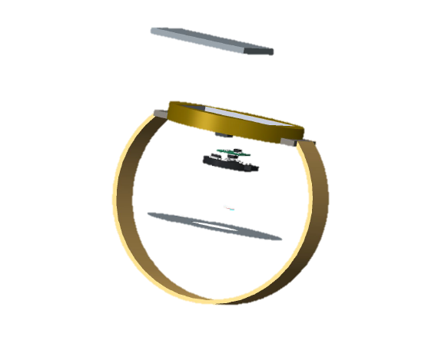
Lifeline
Lifeline is a device worn on the wrist that acts as a link between the user and their carer in the case of an emergency
Lifeline is a unique solution as it does not solely require user input to alert the carer to an emergency
It consists of three different components:
A skin sensitive touch pad
An accelerometer
A heart rate monitor

Slide 4
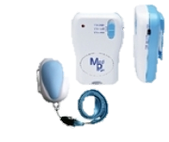
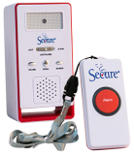
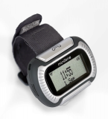
Existing Solutions
There are already a few existing solutions for our problem. However, from our research we found that many users find these solutions:
LIMITED
DIFFICULT TO USE
STIGMATIZING
Currently the most common solution is a pressure sensitive panic button that is connected to a paging device for the carer

Slide 5
Why is a new solution necessary?
From our research into existing solutions and from meeting frequently with our stakeholders we believe a new solution for this problem is necessary because:
Users felt unsafe without an immediate and easy to use communication device on their person to contact help in a case of emergency
Existing solutions are lacking certain elements which would help make the user more confident in the device

Slide 6
Our Solution
Our solution hopes to give greater security to our stakeholders by having three different components:
User friendly skin sensitive emergency touchpad
Accelerometer to alert carers or staff in case of falls
Pulse Monitor alerts carers in the case of an abnormal heart rate

Slide 7
Our Design Process
Generated our three concepts
Chose selected concept based on feedback from stakeholders
Finalized concept and design
Ordered Parts
Began programming digital components
Re-ordered some components
Started combining different components
Implemented coding
Tested design
Final tweaking of design before the showcase
Market research to see what is needed
Brainstorming

Slide 8
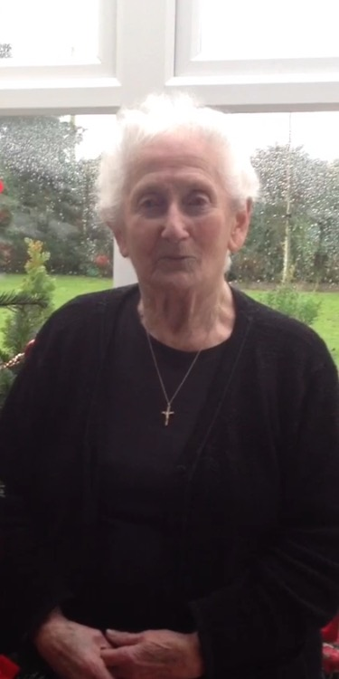
Validation
When we showed our solution to a focus group of 8 residents in Tara Winthrop this was some of the feedback we received:
“I like the way it is less obvious (than the current panic button)” – User #5
“I would feel safer knowing that it wouldn’t necessarily rely on me to activate the alarm” – User #2
“It would make me feel much more comfortable when I’m doing things on my own during the day” – User #1

Slide 9
Benefits
Compared to a standard panic button consisting of a pendant and pager kit, our solution:
Gives more security to the user and their carer
Due to the combined response of three different emergency situation detectors, in the case of a fall/heart attack/stroke etc. the carer will be alerted without the elderly person needing to press the sensor
The panic ‘button’ is easier to activate than a regular pressure sensitive button
The entire device is more discreet for the user

